Slide 1
IPL Dataset
Exploratory Data Analysis
BY
Vinod Kumar Reddy Salkuti
Email : vinod.salkuti@gmail.com

Slide 2
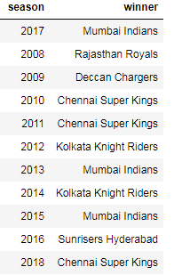
IPL Dataset Visualization
Year Wise IPL Winners
Notes:
Notes:
Mumbai Indians and Chennai super Kings top the List with Three times Champion Each Kolkata Knight riders were two time champions, while Raastan Royals, Ddeccan Chargers and Sunrisers Hyderabad were one time champions each

Slide 3
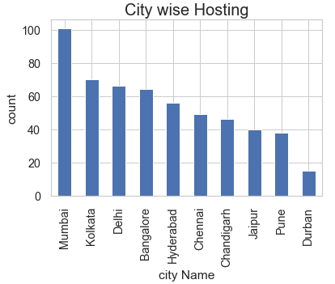
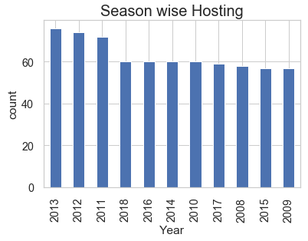
IPL Dataset Visualization
IPL Host Statistics
Notes:
Notes:
Mumbai city has hosted the most number of IPL matches followed by Kolkata and Delhi
Year 2013 has most number of IPL matches followed by 2012 and 2011.

Slide 4
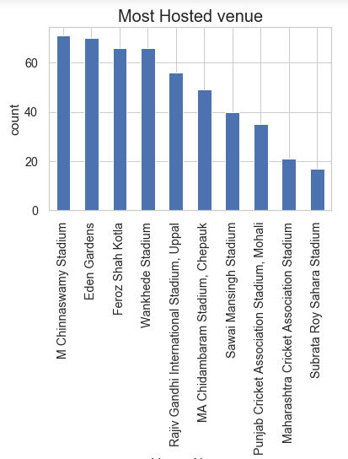
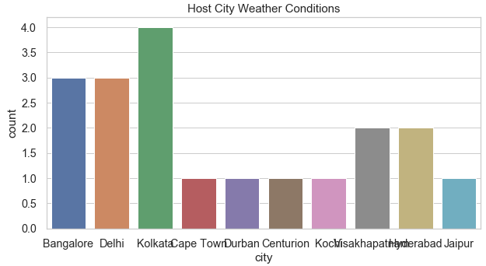
IPL Dataset Visualization
IPL Host Statistics
Notes:
Notes:
M chinnaswamy Stadium has hosted the highest number of matches in IPL followed by Eden gardens and Feroz Shah Kotla.
Kolkata has effected with bad Weather conditions during IPL matches followed by Bangalore and Delhi.

Slide 5
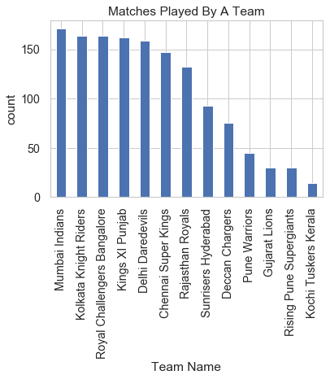
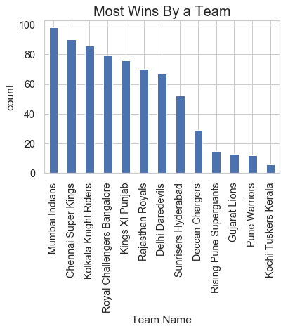
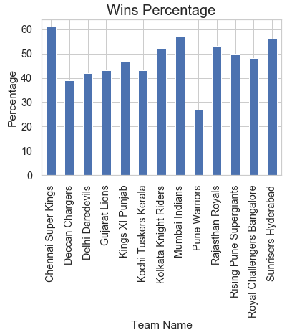
IPL Dataset Visualization
Match Statistics
Notes:
Notes:
Mumbai has played the Most number of IPL matches followed by Koklata Knight Riders and Royal Challengers Bangalore.
Mumbai Indians has won the highest number of matches in IPL followed by Chennai Super Kings and Kolkata Knight Riders.
Even though Mumbai has won highest number of matches, They have played highest number of matches too. But according to Wins percentage , chennai Super Kings is the Most successful Team in IPL followed by Mumbai Indians and Sun Risers Hyderabad

Slide 6
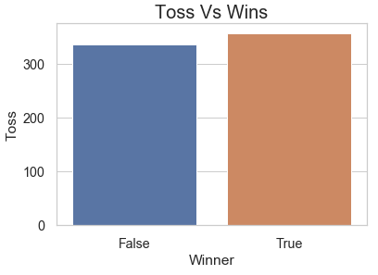
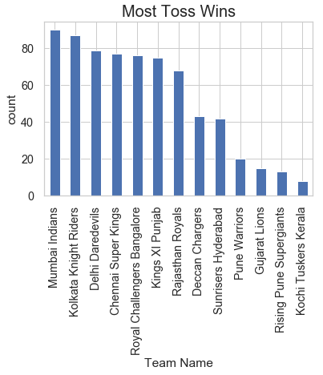
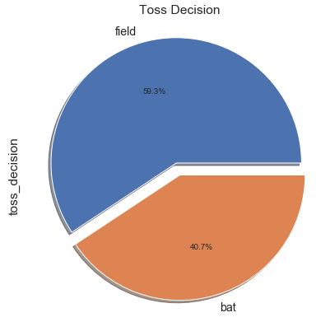
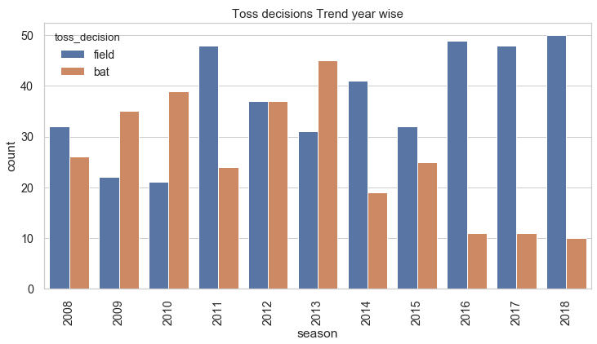
IPL Dataset Visualization
Toss Statistics
Notes:
Note s:
Mumbai Indians has won the "Toss" most number of times followed by Kolkata Knight riders and Delhi Daredevils.
Most of the times teams have chosen to Bowl First when they won the Toss.
Team which won the Toss has won the match most of the times but there is not a huge difference observed, So there is a Slight Toss Luck factor worked.
In initial years of IPL , Teams have choosen to bat First ,but later the trend changed and in recent IPL's teams have mostly choosen to field first if they won First.

Slide 7
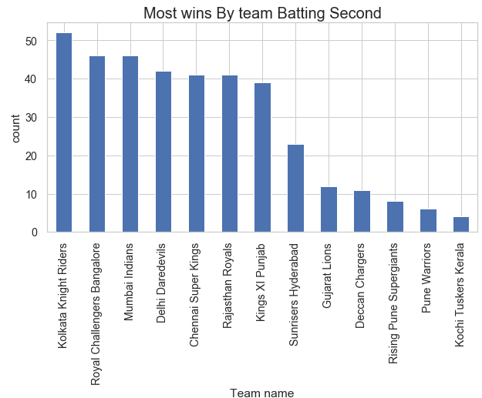
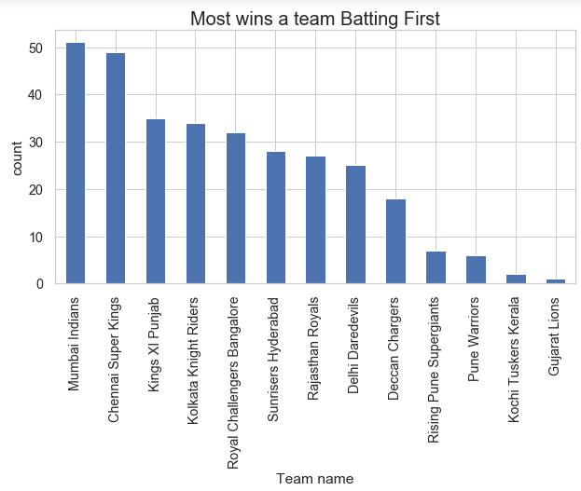
IPL Dataset Visualization
Batting First VS Batting Second
Notes:
Notes:
Kolkata Knight rider's has won most matches Batting Second followed by Royal Challengers Banglore and Mumbai Indians
Mumbai Indians has won highest number of matches when batting First followed by Chennai Super Kings and Kings XI Punjab.

Slide 8
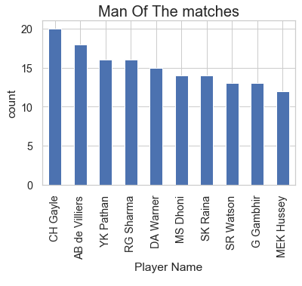
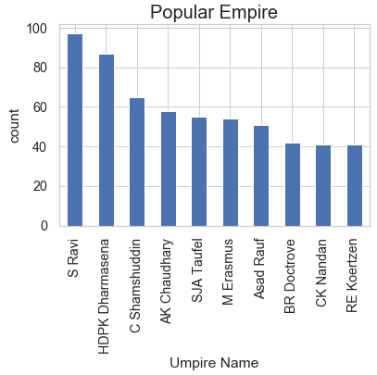
IPL Dataset Visualization
Most MOM and Popular Empire
Notes:
Notes:
Universal Boss "Chris gayle" tops the list with most MOM's followed by Mister 360 "AB de Villiers" and yusuf K Pathan.Surprisingly No Virat Kohli in Top 10 . Also list has been dominated with batsmen.¶
S Ravi is the most Popular empire followed by HDPK Dharmasena and C Shamshuddin

Slide 9
IPL Dataset Visualization
Insights and recommendations:
From analysis and data visulization , IT clearly indicates that IPL was mostly dominated by Mumbai Indians ,Chennai Super Kings and Kolkata Knight Riders as they were in one of the first three positions in almost all the aspects.
Team other than above mentioned need to improve their performance so that IPL becomes more competitive in coming seasons.
Can take Weather conditions into account while scheduling IPL matches so that they won’t end in No result.

